Slide 1
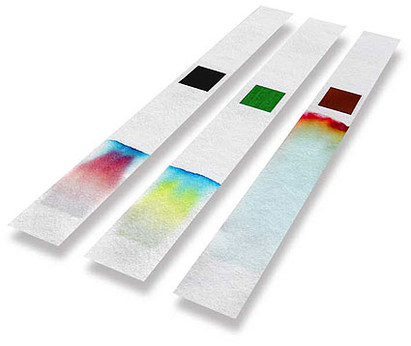
Coffee Filter Chromatography
Elementary School
Fall 2012
Vanderbilt Student Volunteers for Science
Training Presentation

Slide 2
Definitions to Learn
Mixtures- A combination of two or more substances that are not chemically united.
Separation- The process of separating the components of a mixture.
Chromatography- The term for techniques used to separate mixtures
Chromatogram- The paper strip that all of the constituents of the mixture have been separated on by color
Capillary Action- Liquid is pulled up through a solid depending on its adhesive and cohesive properties.

Slide 3
I: What is Chromatography?
Explain the scientific definition of a mixture
Discuss how chromatography can be used to separate mixtures.
Briefly mention how the lesson will be using paper chromatography to separate different food coloring dyes.
Do not pass out materials until you have done this introduction.

Slide 4
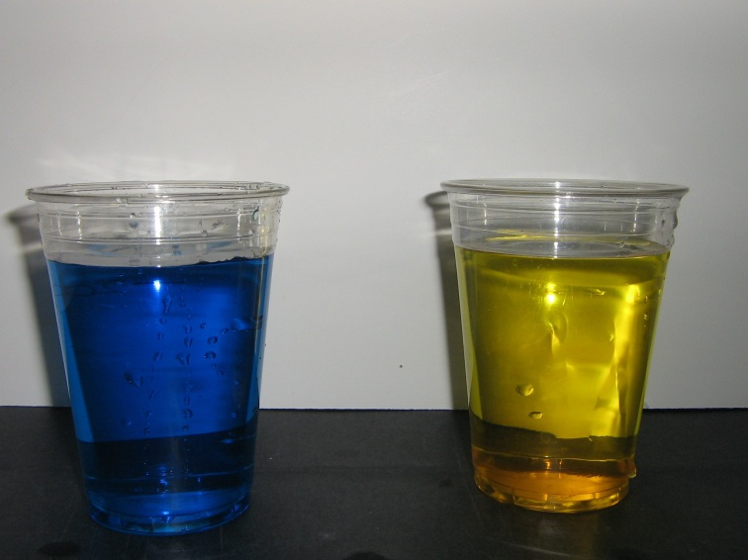
IIA: Mixing Colors
Fill two 10 oz cups half full with water
Add yellow food coloring to one cup and blue food coloring to the other cup.
Stir cups and show the two different colors to the students.
Ask students what color you get when you mix blue and yellow.

Slide 5
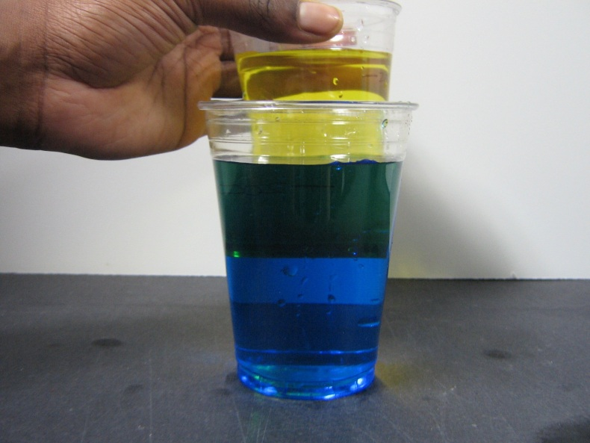
IIB: Mixing Colors
Hold the cup of yellow water behind and slightly above the cup of blue liquid.
Have students observe how the yellow and blue overlap becomes green.
Ask students what color the liquid in the middle is.
Yellow
Green
Blue

Slide 6
IIC: Mixing Colors
Ask students what will happen if you pour some of both liquids into a third glass.
Pour some of the blue liquid and yellow liquid into a third cup and show students that the mixture is green.
Tell students that mixing colors is something we know how to do. Instead, we want to discover a way to separate the colors and other mixtures.

Slide 7
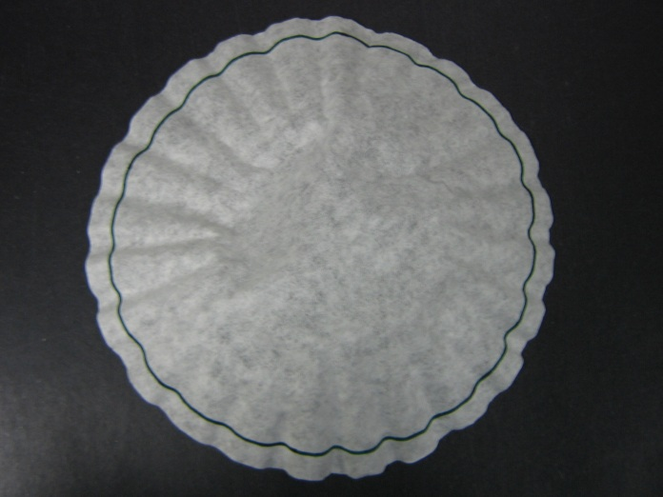
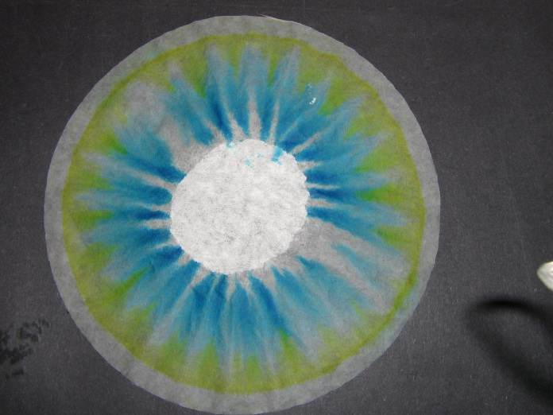
III: Demonstration of Chromatography Procedure
Draw a ring of green around the filter with a green pen.
Pour a small amount of water (~1/4”) into a plate.
Place the coffee filter upside down so that it is sitting in the water in the plate.
Let the water rise up the filter. Do not disturb the filter.
Explain to students what capillary action is. The liquid travels up the filter through pores or capillaries in the filter.

Slide 8
IV: Separating Green into Blue and Yellow Experiment
Put students into pairs.
Give each pair a plate, coffee filter, and green pen.
Have students repeat your experiment, giving help when needed.
While students perform and observe the experiment, explain that colors separate because they are made of different pigments.
Each pigment travels a different distance, because some colors are more strongly absorbed by the paper.
The differences in distances allows us to separate the colors in a mixture.
Ask students which colors separate and which travel further up the filter.

Slide 9
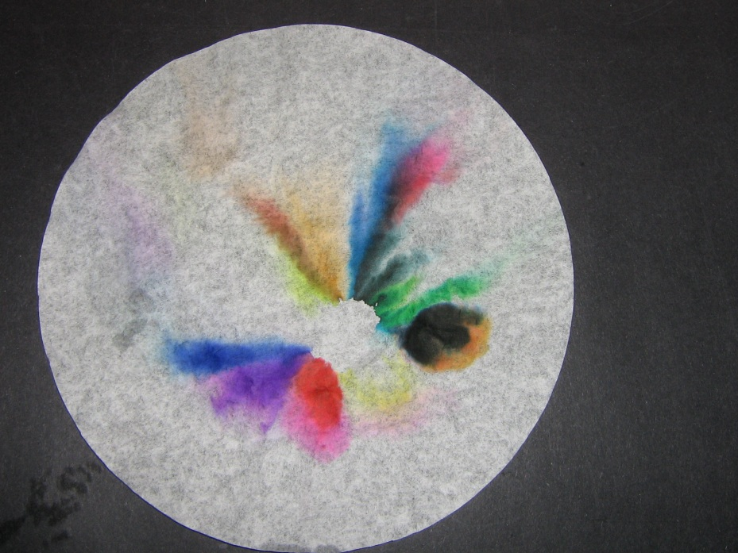
V: Separating Other Colors
Give a coffee filter to each student, and pass out a set of markers to each group of four.
Tell students that they can draw any design on the filter on the line marked around the bottom edge of the coffee filter.
Help students place filters into plates of water.
Allow the setup to run for five-ten minutes or until the water is close to the top of the filter paper.
Let the filter paper dry for several minutes.

Slide 10
Clean-Up and Summary
Students may keep the filter papers. Throw them away if they don’t.
Remove water from plates and gather all the markers and pens back.
Rinse used cups.
Review what students learned today. See if they remember the definitions.

